Slide 1
EVACGLOW – Real-Time Fire Detection and Safe Path Indicator
Project By:
Mohammed Shameem S
Prithikshan S
Rahul V
Rohith AM

Slide 2
INTRODUCTION
EVACGLOW is an intelligent fire detection and evacuation guidance system designed for enclosed public and industrial spaces.
The system combines multiple sensors (temperature, flame, smoke, presence) to monitor real-time path conditions.
It provides automated evacuation suggestions by indicating the safest available route using LEDs, servo-controlled doors, an LCD display, and a buzzer.
Developed with a user-centric and energy-efficient design approach, it only activates when human presence is detected.
Aims to reduce confusion and delay during fire emergencies and assist in structured evacuation.

Slide 3
PROBLEM STATEMENT & RELEVANCE
In emergencies like fires, people often panic due to a lack of real-time guidance, leading to confusion and unsafe evacuation decisions.
Existing systems are either alarm-based or passive, lacking intelligent path control or dynamic redirection.
Most setups are not energy-efficient, operating continuously regardless of human presence.
The need exists for a smart, integrated system that can sense danger, detect human presence, and guide occupants to safety through the safest available route.
EVACGLOW addresses this critical gap with real-time monitoring, controlled pathways, and interactive alerts.

Slide 4
EXISTING METHODS & LIMITATIONS
Conventional fire alarms rely mainly on buzzers or sirens, offering no direction or guidance.
Lack of automation: Most systems don’t include any physical control over evacuation routes (e.g., doors or barriers).
No human presence detection – systems run continuously, wasting power.
No integration of multiple sensors (smoke, flame, temperature) for intelligent decision-making.
Most setups are room-specific, lacking scalability and centralized communication.
No real-time display or status feedback for occupants during emergencies.

Slide 5
PROPOSED / INNOVATIVE METHOD
EVACGLOW is a smart fire detection and evacuation system.
Monitors two independent paths using:
MQ2 Smoke Sensor
IR Flame Sensor
DHT11 Temperature Sensor
Ultrasonic sensor detects human presence to activate system only when needed (power-saving).
LED indicators show path status:
🟢 Safe | 🔵 Caution | 🔴 Fire (blinking)
I2C LCD displays real-time messages (e.g., “Path 1: Safe”).
Buzzer gives intermittent alert during fire.
Servo motors automatically open safest escape path.

Slide 6
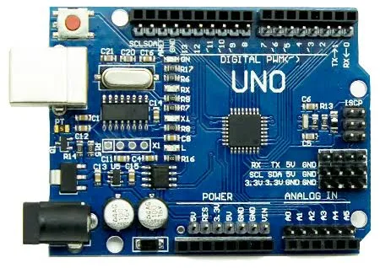

HARDWARE / SOFTWARE IMPLEMENTATION
Hardware:
Arduino Uno R3
Sensors: MQ2, IR Flame, DHT11 (x2 each)
Ultrasonic sensor for human detection
I2C 16x2 LCD, LEDs, buzzer
Servo motors for physical path redirection
Powered using external 5V/12V supply
Software:
Arduino IDE (C/C++)
Libraries: Wire.h, LiquidCrystal_I2C.h, DHT.h
Serial monitor for debugging and real-time sensor data logging

Slide 7
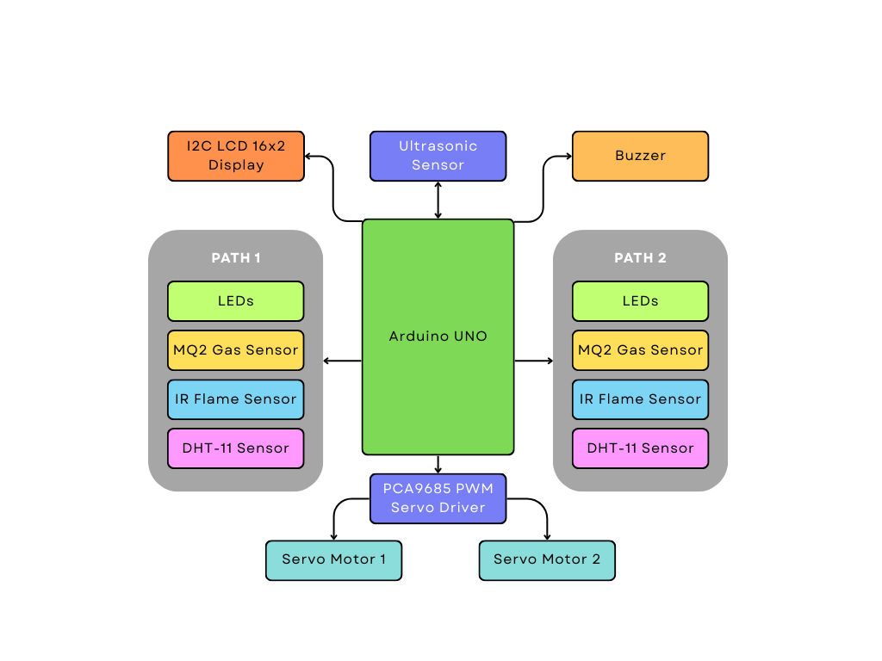
BLOCK DIAGRAM

Slide 8
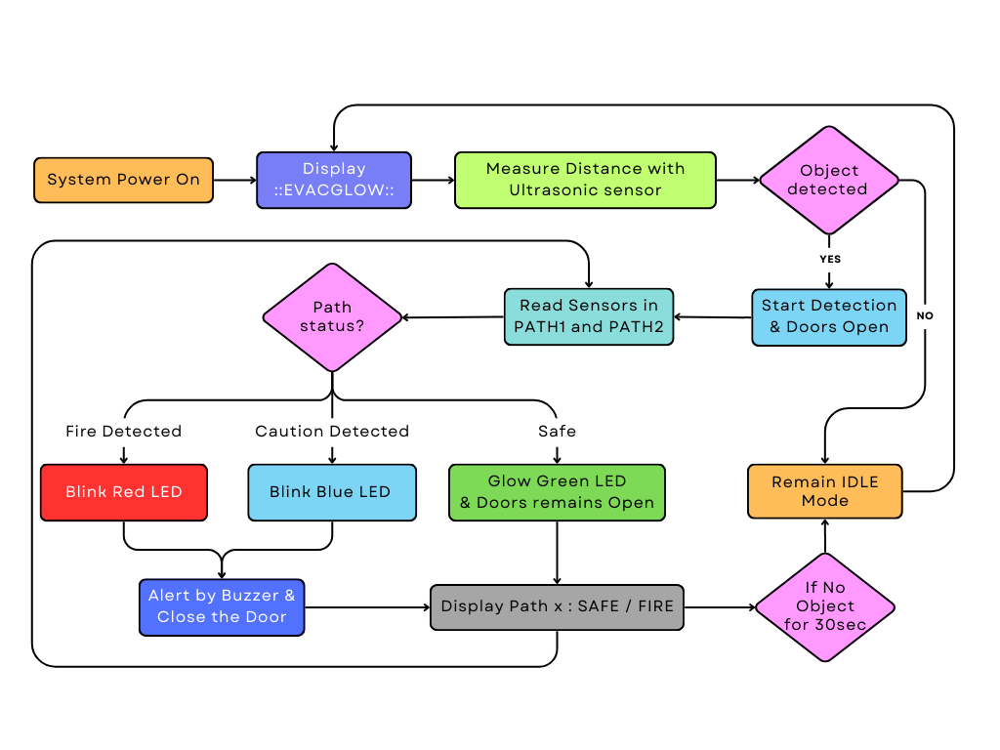
FLOWCHART

Slide 9
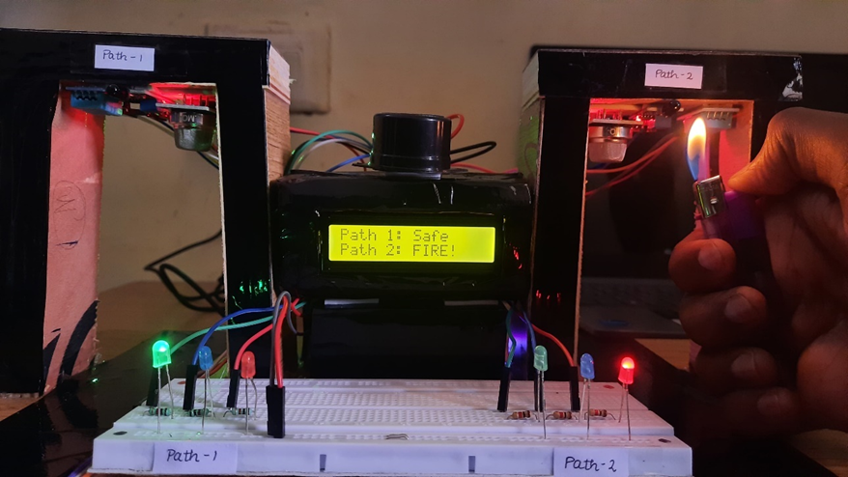
EXPERIMENTAL RESULTS
Path 2 shows fire: buzzer alerts + red LED blinking
Path 1 remains safe: green LED ON, servo opens the route
Path | Temp (°C) | Smoke (Analog) | Flame | Status | Door
1 | 28.5 | 150 | No | ✅ Safe | Open
2 | 54.2 | 380 | Yes | 🔥 Fire | Closed

Slide 10
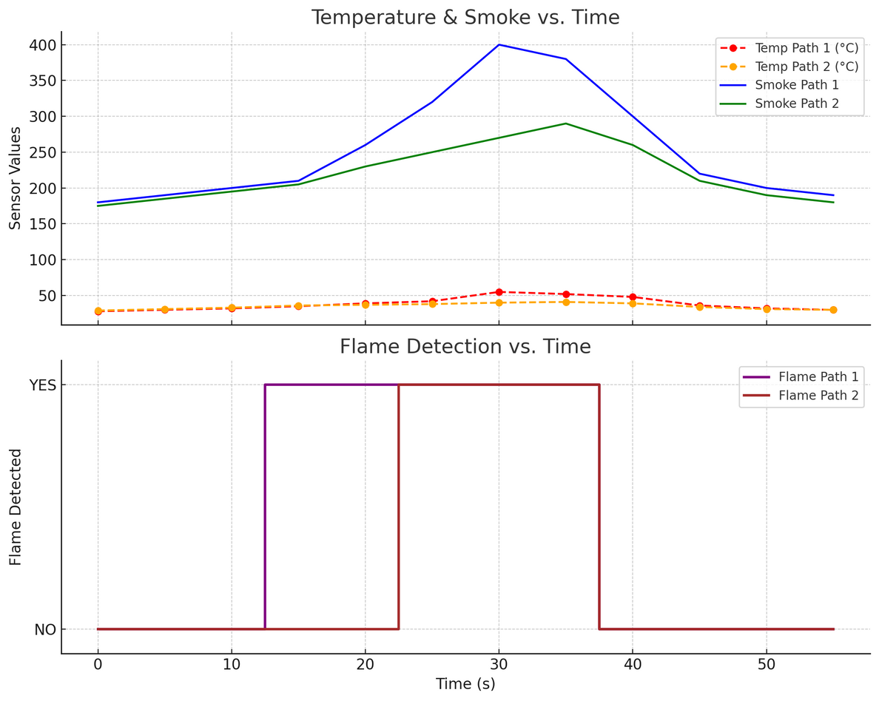
EXPERIMENTAL RESULTS
Fire status determined by any of three parameters exceeding threshold
System response:
🔒 Unsafe path = servo closes
🔓 Safe path = servo opens
Smart decision-making without cloud dependency

Slide 11
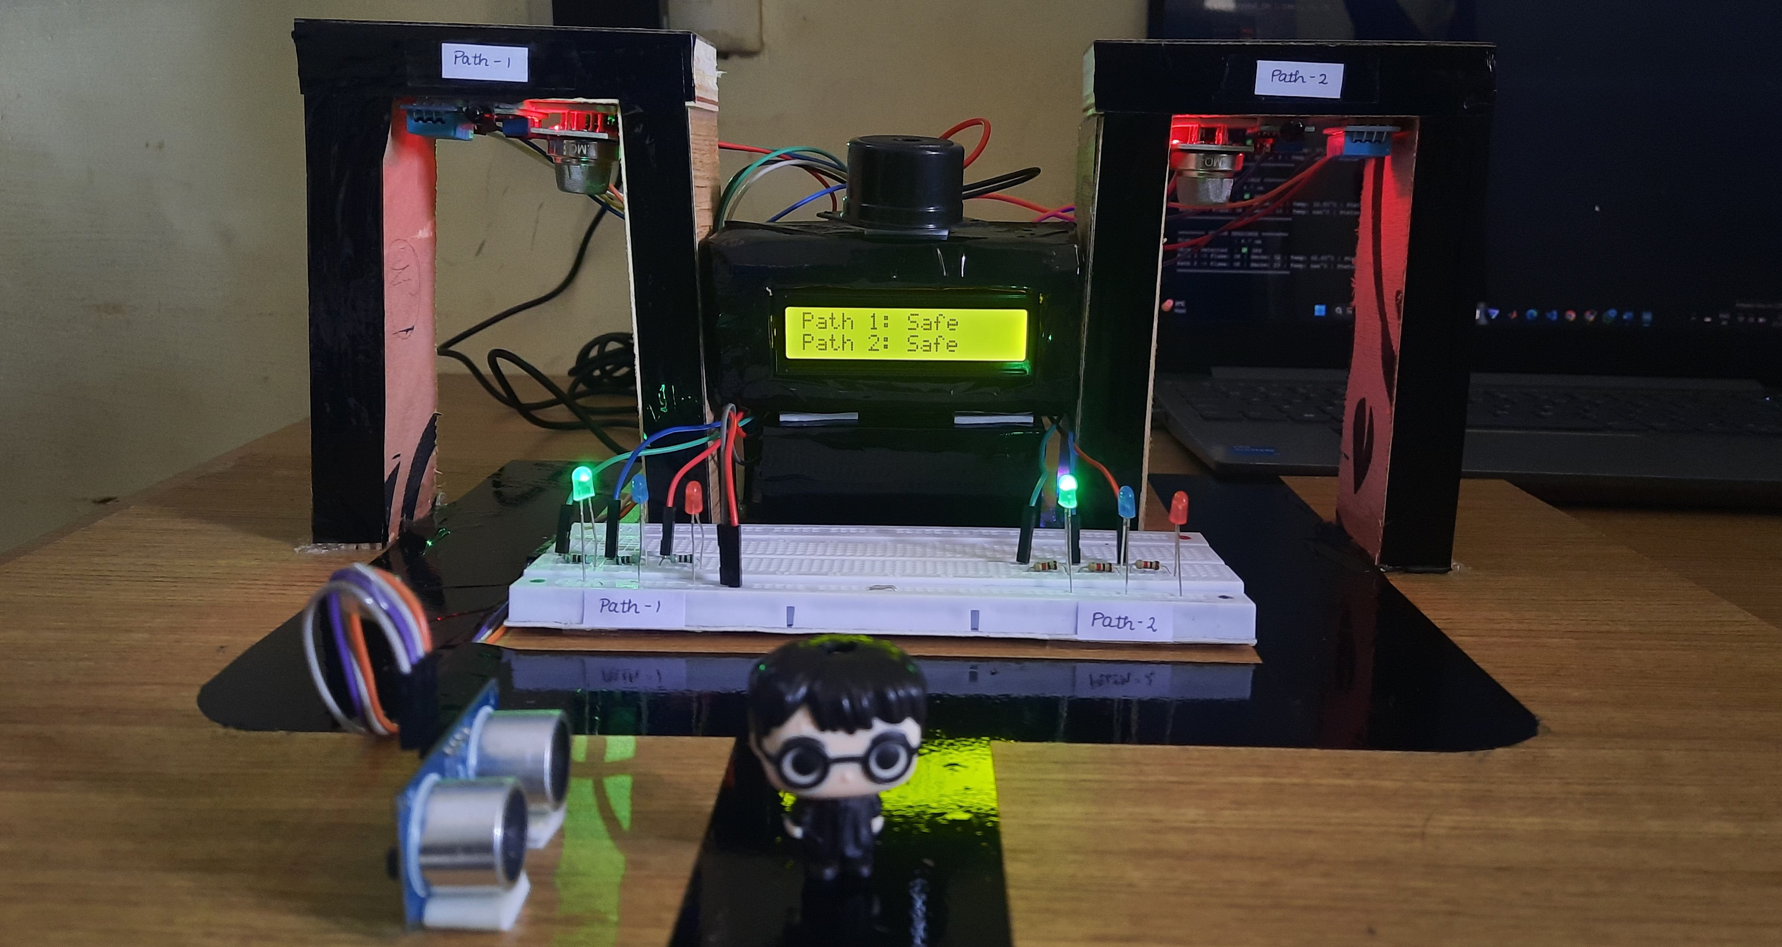
PROTOTYPE

Slide 12
UNIQUENESS & DIFFERENTIATORS
Combines detection, direction, and actuation in a single system
Smart activation only when human is present
Uses servo-driven path control – unlike traditional passive systems
Works offline – no reliance on internet/cloud
Modular and scalable – can expand to multi-room systems

Slide 13
UTILITY & VALUE PROPOSITION
Prevents panic by giving clear, visible, and audible guidance
Increases survival rate through intelligent redirection
Conserves power via presence detection
Enables early fire detection with multiple sensor types
Ideal for schools, hospitals, offices, malls, etc.

Slide 14

SUSTAINABILITY & IMPACT
Economic Sustainability:
Uses affordable components
One-time installation cost, minimal maintenance
Can be commercialized as a modular kit
Environmental Sustainability:
Energy-efficient: activates only on demand
Reduces false alarms and resource waste
Promotes sustainable smart infrastructure

Slide 15
CONCLUSION & FUTURE WORK
EvacGlow provides a reliable, real-time fire detection and evacuation guidance system using smart sensors and intuitive alerts. It ensures user safety by detecting hazards and directing people toward the safest path through LEDs, LCD messages, and buzzer alerts. The system is power-efficient, cost-effective, and ideal for small to medium indoor spaces like classrooms, offices, and hospitals.
Future Work:
Add wireless communication (Wi-Fi/GSM) for remote alerting.
Integrate with mobile apps for live monitoring.
Expand system to support more paths or multiple floors.
Use AI for predictive fire analysis and adaptive path control.
Design a compact PCB and protective housing for deployment.

Slide 16
THANK YOU

